Slide 1
Software Testing: Introduction
Greg Watson (he/him)
Oak Ridge National Laboratory
Developing a Testing and Continuous Integration Strategy for your Team tutorial @ Exascale Computing Project Annual Meeting
Contributors: Anshu Dubey (ANL), Patricia Grubel (LANL), Rinku Gupta (ANL), Alicia Klinvex (SNL), Mark C. Miller (LLNL), Jared O’Neal (ANL), David M. Rogers (ORNL), Gregory R. Watson (ORNL)
Notes:
Hello, everyone. I'm _from. ___. In this module I’m going to be talking about software testing and how it is used in the development process for scientific computing.

Slide 2
License, Citation and Acknowledgements
License and Citation
This work is licensed under a Creative Commons Attribution 4.0 International License (CC BY 4.0).
The requested citation the overall tutorial is: Gregory R. Watson and David M. Rogers, Developing a Testing and Continuous Integration Strategy for your Team tutorial, in Exascale Computing Project Annual Meeting, online, 2022. DOI: 10.6084/m9.figshare.19608927
Individual modules may be cited as Speaker, Module Title, in Better Scientific Software tutorial…
Acknowledgements
This work was supported by the U.S. Department of Energy Office of Science, Office of Advanced Scientific Computing Research (ASCR), and by the Exascale Computing Project (17-SC-20-SC), a collaborative effort of the U.S. Department of Energy Office of Science and the National Nuclear Security Administration.
This work was performed in part at the Argonne National Laboratory, which is managed by UChicago Argonne, LLC for the U.S. Department of Energy under Contract No. DE-AC02-06CH11357.
This work was performed in part at the Oak Ridge National Laboratory, which is managed by UT-Battelle, LLC for the U.S. Department of Energy under Contract No. DE-AC05-00OR22725.
This work was performed in part at the Lawrence Livermore National Laboratory, which is managed by Lawrence Livermore National Security, LLC for the U.S. Department of Energy under Contract No. DE-AC52-07NA27344.
This work was performed in part at the Los Alamos National Laboratory, which is managed by Triad National Security, LLC for the U.S. Department of Energy under Contract No.89233218CNA000001
This work was performed in part at Sandia National Laboratories. Sandia National Laboratories is a multi-mission laboratory managed and operated by National Technology and Engineering Solutions of Sandia, LLC., a wholly owned subsidiary of Honeywell International, Inc., for the U.S. Department of Energy’s National Nuclear Security Administration under contract DE-NA0003525.

Slide 3
Software Testing - Outline
Testing Introduction
What is testing?
Challenges of testing
Simple Examples
Walk Through Testing Example
Testing Examples
Notes:
This module is divided into two parts. In the first part, I’ll introduce some testing concepts and terminology, talk about some of the challenges of testing in the context of scientific computing, and then show you a simple example of how you can set up a Python project with testing, as well as how to use CMake’s ctest framework for a C/C++ project. In the second part, I’ll walk through how to use a testing methodology on a larger and more complex project.

Slide 4

General Categories of Testing
Development tests
Tests run to protect stability while making changes to the code
Can include: unit, functional, integration, system, regression, verification, performance, etc.
Post-installation “smoke” tests
Simple tests to ensure the build/install process has succeeded
Typically take only a few minutes
Could be a subset of development tests
Continuous integration tests
Rapid feedback aimed at preventing changes from breaking key branches of the code
Run quickly, fail fast, catch problems that would impact other developers
Usually associated with automation
Code coverage,
Complexity
acceptance
system
test suite
functional
unit tests

Slide 5
Example types of testing
Unit testing – verify the execution of a single routine
Integration testing – verify that modules or components execute correctly
System testing – verify that the program operates correctly as a whole
Regression testing – comparison with previous output to determine if unintended changes have been introduced
Acceptance testing – verify that the program meets customer requirements or not
Note that this is neither a complete nor prescriptive list of testing types. There are many other types of tests. Sometimes it can be beneficial to combine testing strategies, such as testing the interoperability of modules and components at the system level.
Notes:
There are many different types of tests and testing strategies. We’ll just mention a few common ones here. Unit testing is used to check that a single routine or function is operating correctly. Integration testing is used to check that a group of modules or components operate correctly together. System testing checks that the program operates correctly as a whole and meets the specified requirements. Regression testing is used to check that changes introduced into the code have not made any unintended changes to the program behavior. Acceptance testing is similar to system testing in that it checks the program as a whole. However instead of checking with respect to the specifications, it is used to ensure that the program meets the requirements of the customer.

Slide 6
What about Verification and Validation?
Scientific computing and software engineering use different definitions
 | Scientific computing | Software engineering
Verification | Confirms the mathematical accuracy and stability of a numerical solution in addition to specifications. | Confirms that the software conforms to its specifications (i.e. requirements.)
Validation | Confirms the physical accuracy of a given model by comparing against experimental data. | Confirms that the software actually meets the customer’s needs.
Validation in scientific computing requires a comparison to the experimental data, whereas in software engineering it is based on customer needs
Also, for a real problem, there is typically no way to check for correct output given some inputs. Validation is still required however, so an indirect method must be used.
Notes:
So how does testing relate to verification and validation? Unfortunately the terminology is different if you’re talking about scientific computing or software engineering. Software verification is checking that the software conforms to the requirements and design. Software verification is not just testing, but testing plays a role in the verification process to check that each aspect of the software is working the way it is supposed to. For scientific computing, verification aims to ensure that the code is a correct representation of an underlying mathematical model. Thus verification will involve comparing model solutions to reference solutions, checking for convergence, etc. The aim of software validation is to determine if the code meets the customer’s needs, so requires system-level or acceptance testing to be performed. Validation in scientific computing is more complex. It involves determining the accuracy of the model by comparing outputs with experimental results. It may also involve using the computational model to make predictions that can be verified.

Slide 7
Testing within the software development lifecycle
Testing within the software development lifecycle
Notes:
Scientific software development is a complex process, involving expertise in many different subject areas. Domain experts have a set of models in mind, and will propose equations required to solve the problem. They should also have considered validation checks arising from physical and mathematical properties of their models: like conserved quantities and analytical solutions. Applied mathematicians work with solvers and discretizations. They should contribute a good understanding of function spaces and convergence criteria - which address model fidelity, accuracy, and stability. Computer scientists map problem details into programming languages. They contribute extensible and interoperable frameworks that maximize both productivity and performance.
For the project team to work together effectively, they need to iterate on features that move toward their science objectives. Testing happens at many points in this process, and is essential for ensuring that the desired outcomes are achieved.

Slide 8
Testing within the software development lifecycle
When should functional tests be provided?
Ideally before the code is written
Also known as test driven development (TDD)
Tests then become the specification for the program
This approach also ensures that thought is given to what it means for the program to be correct, rather than just what the program should do
Requires:
Care in writing tests
Frequent running of tests (see our Continuous Integration module)
Wide adoption by development team
Notes:
Testing is required at many points during the software development lifecycle. But when do you actually write tests? Often testing is left until last. The code is written and then tests are added either to meet requirements, or to address deficiencies, or perhaps a bug has been encountered and the vendor requires tests the demonstrate the issue. However rather than adding tests as an afterthought, best practice in software engineering encourages tests to be written before the code. This is known as test driven development. One of the advantages of this approach is that developers think about what it means for the program to be correct, not just what it should do. Another advantage is that the tests become the specification. There are some challenges to this approach however...

Slide 9
Steps for test driven development
Write a single test¹ describing an aspect of the program
Run the test, which should fail because the feature does not exist
Write just enough code to make the test pass
Refactor the code
Repeat, creating new tests as new functionality is added
¹In numerical methods there are times when a single test may not suffice
Notes:
This methodology has been found to be successful broadly across the software engineering community. First a test describing an aspect of the program is written. The tests a run, and this new test will fail because the feature doesn't exist. Just enough code to make the test pass is then written. We do this to ensure that we're not implementing more functionality than the test will be able to check. The tests are re-run and additional code changes made until the test passes. Once the test passes, the code is refactored to tidy it up, remove any redundant code, and make sure it conforms to any project requirements.

Slide 10
Challenges of Testing Complex Software Systems
Designing tests
Complex software tends to have an extensive network of interdependencies
For complex scientific software it may be hard to construct a priori tests for some cases
Exploratory software implies the outcome is not known or when the model is valid
Validation from domain experts feeds back into the design
Implementing tests
Introducing testing into legacy code (legacy == untested)
Original verification has been lost in the mists of time.
Assumptions, conditions, interactions unknown: “Bad code or necessary evil?”
Understanding and progressively improving code coverage

Slide 11
More Challenges of Testing Complex Software Systems
Automating tests
Just get started – easy to get lost in all the options
You must have tests to be able to automate them!
Automation does not just mean running every test you have
What to run where, and when?
Consider what resources are required, and what the tests are used for

Slide 12
How do we determine what tests are needed?
Code coverage tools
Expose parts of the code that aren’t being tested
gcov - standard utility with the GNU compiler collection suite (we will use it in the next few slides)
Compile/link with –coverage & turn off optimization
Counts the number of times each statement is executed
Necessary for testing, but not sufficient
gcov also works for C and Fortran
Other tools exist for other languages
JCov for Java
Coverage.py for python
Devel::Cover for perl
profile for MATLAB
Lcov
a graphical front-end for gcov
available at http://ltp.sourceforge.net/coverage/lcov.php
Codecov.io in CI module
Hosted servers (e.g. coveralls, codecov)
graphical visualization of results
push results to server through continuous integration server
Notes:
Even if you follow the TDD methodology, it is useful to know how much code is actually being tested.

Slide 13
Summary
A testing strategy is essential for producing reliable trustworthy software
Invest the time needed to thoroughly test your software at all levels
Use automation whenever possible
Different challenges are associated with exploratory, legacy, and composable codes
Adapt your strategy to fit your situation.
Eventually you will want to be able to verify all components in a code release.
Don’t get distracted by all the technologies out there – focus on exercising your code.
Scaffolding projects can help with mechanics.

Slide 14
Going Further
C, C++, Fortran
Running and Reporting Tests: ctest / cdash / pFUnit / FlashTest
Code Coverage: gcov / lcov (C, C++, Fortran)
Static Analysis: clang-tidy (only C, C++)
Python
Running and Reporting Tests: pytest / unittest / nose
Code Coverage: pytest-cov
Static Source Code Analysis: pylint / flake8
Notes:
If you've passed these initial hurdles, and you want to go further, there are yet more options to explore. I already mentioned ctest and pytest for compiled and python codes. Test coverage for compiled codes can be checked with gcov, or ell-cov (to output browsable HTML). Static source code analysis is provided by compiler warnings, but also by the clang-tidy project (for C++). In python, you can use pytest-cov for coverage and pylint or flake8 for static source code analysis.

Slide 15
Hands On Activities
Simple Python and C++ examples
Checking code coverage example
Test driven development example
Notes:
If you've passed these initial hurdles, and you want to go further, there are yet more options to explore. I already mentioned ctest and pytest for compiled and python codes. Test coverage for compiled codes can be checked with gcov, or ell-cov (to output browsable HTML). Static source code analysis is provided by compiler warnings, but also by the clang-tidy project (for C++). In python, you can use pytest-cov for coverage and pylint or flake8 for static source code analysis.

Slide 16

Python Example
$ pip install pyscaffold
$ pip install tox
$ putup autoQCT
$ cd autoQCT # tests in tests/ subdir.
$ tox
default run-test: commands[0] | pytest
======================= test session starts ========================
platform darwin -- Python 3.9.0, pytest-6.2.2, py-1.10.0, pluggy-0.13.1 -- plugins: cov-2.11.1
collected 2 items
tests/test_skeleton.py::test_fib PASSED [ 50%]
tests/test_skeleton.py::test_main PASSED [100%]
---------- coverage: platform darwin, python 3.9.0-final-0 -----------
Name Stmts Miss Branch BrPart Cover Missing
---------------------------------------------------------------------
src/autoqct/__init__.py 6 0 0 0 100%
src/autoqct/skeleton.py 32 1 2 0 97% 135
---------------------------------------------------------------------
TOTAL 38 1 2 0 98%
======================== 2 passed in 0.07s =========================
default: commands succeeded
congratulations :)
pyscaffold.org
Notes:
In the first example, I’m going to show you how to set up a new Python project that you can immediately start using to develop tests and implement code. Although it’s pretty easy to start coding Python using Jupyter notebooks or just a simple text file, it’s more complex to create a maintainable package that can be distributed via a package manager such as PyPi. First we need to install a couple of python packages. We’re going to use pyscaffold to create a Python package that includes setup.py and other files needed for Python’s build process. We’re then going to use Tox to manage the tests for the project. Once we’ve installed pyscaffold and Tox, we can create the new project using the ‘putup’ command. This will create a package containing a skeleton file and an associated test. The ‘tox’ command will then run the tests using the pytest command Note, it even provides a neat summary of code coverage - how many lines of your program are exercised by one of the tests.
You can customize the template to import your own project files and test them. It also has some nice pre-sets for documenting with Sphinx and releasing your package to the pypi package repository.

Slide 17

CMake Example
$ cat >CMakeLists.txt <<.
cmake_minimum_required(VERSION 3.8)
project( blank )
set(CMAKE_CXX_STANDARD 11)
set(CMAKE_CXX_STANDARD_REQUIRED ON)
include(blt/SetupBLT.cmake)
.
$ git clone https://github.com/LLNL/blt/
$ mkdir build && cd build
$ cmake ..
$ make –j
llnl-blt.readthedocs.io
...
[100%] Linking CXX executable ../../../tests/blt_gtest_smoke
[100%] Built target blt_gtest_smoke
$ make test
Running tests...
Test project /Users/99r/work/autoQCT/blank_project/build
Start 1: blt_gtest_smoke
1/1 Test #1: blt_gtest_smoke .................. Passed 0.46 sec
100% tests passed, 0 tests failed out of 1
Total Test time (real) = 0.46 sec
Notes:
For codes based on C, C++, and Fortran, the CMake build system is very popular. CMake provides an easy way to build tests with its `ctest` framework. Using that really just requires you to call `add_test` inside your cmake file. After writing a few tests that way, however, you'll probably want to use a library like google-test or catch2 to make your tests more readable. The BLT project provides a set of cmake files designed for building with google-test (for C) or FRUIT (for Fortran), doing code coverage, and CI. One of its best features is that it's well-documented, so the instructions tell you exactly how to add it to your project. It also has shortcuts for creating nice documentation with doxygen plus Sphinx. The terminal output I'm showing here demonstrates that you can build an "empty" project and get tests working out of the box.

Slide 18
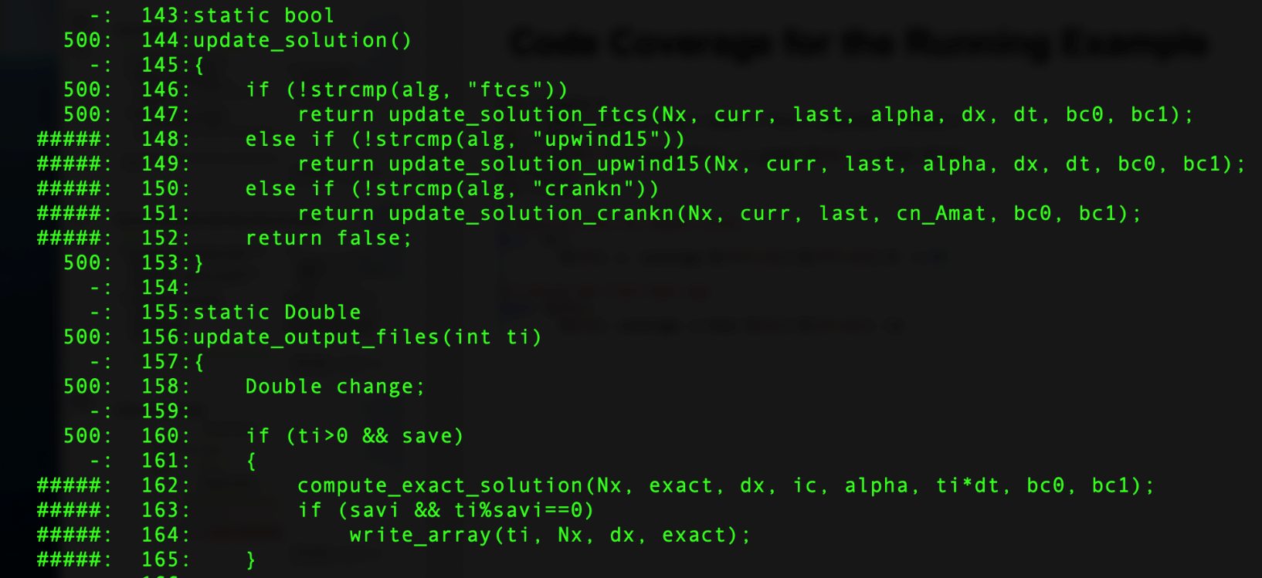
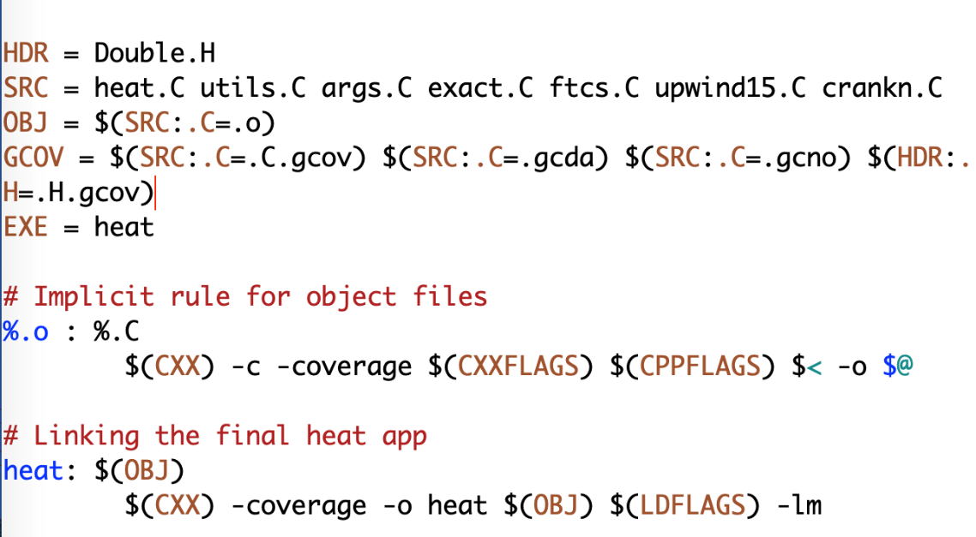
Checking Code Coverage Example https://github.com/bssw-tutorial/hello-numerical-world
Example of heat equation
Add -coverage as shown below to Makefile
Run ./heat runame=“ftcs_results”
Run gcov heat.C
Examine heat.C.gcov
A dash indicates non-executable line
A number indicated the times the line was called
##### indicates line wasn’t exercised

Slide 19
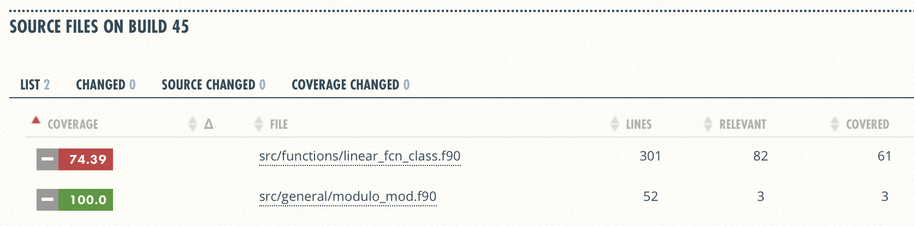
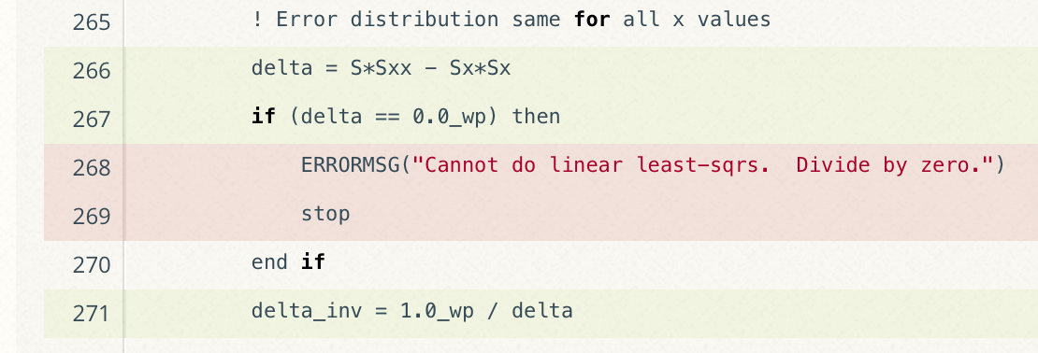
Graphical View of Gcov Output and Tutorials for Code Coverage
Coverage Summary
Line-by-line details
Online tutorial - https://github.com/amklinv/morpheus
Other example - https://github.com/jrdoneal/infrastructure
Notes:
Here's an example of the graphical coverage summary you can get with hosted services. There's youtube tutorials for implementing these sorts of things.

Slide 20
Test Driven Development Example
https://github.com/bssw-tutorial/hello-numerical-world/tree/main/tdd-example
$ wc *.C
125 494 4161 args.C # parse arguments
220 718 5667 heat.C # main() – stores all vars
151 498 3888 utils.C # l2_norm, write, copy, init
26 119 820 ftcs.C # standard, centered stencil
27 123 833 upwind15.C # alternate integration schemes
94 344 2134 crankn.C
43 190 1299 exact.C # comparison solution
{
Lots of setup code – prepares problem for kernel calls
Isolated, swappable kernel calls
Imagine adding kernels to larger, multi-physics application.
How do we add new kernels using test driven development?

Slide 21
Build and run the code
$ cd tdd-example
$ cmake .
$ make
$ ./heat alg=ftcs outi=0 maxt=-5e-8 ic="rand(0,0.2,2)"
runame="heat_results"
alpha=0.2
lenx=1
dx=0.1
dt=0.004
maxt=-5e-08
bc0=0
bc1=1
ic="rand(0,0.2,2)"
alg="ftcs"
…
Stopped after 001490 iterations for threshold 2.46636e-15

Slide 22
Add a new kernel
Need to add test first
What to test?
ensure arguments are correct, bad cases detected, etc.
steady-state (should be straight line)
external script can test file write() as well
solution time-dependence vs. reference
(d/dx)² sin(ax) = -a² sin(ax)
test multiple precisions
combinatorial problems – listing tests in for() or matrix...
exact(x)
curr(x)
x
error?

Slide 23
check.sh will check for steady state
$ sh check.sh ./heat ftcs
runame="check_ftcs"
alpha=0.2
lenx=1
dx=0.1
dt=0.004
maxt=-5e-08
bc0=0
bc1=1
…
Stopped after 001490 iterations for threshold 2.46636e-15
Error = 0
exact(x)
curr(x)
x
error?
steady-state test
(should be straight line)

Slide 24
Create our tests before we write the code
$ mkdir tests
$ cp check.sh tests/check.sh
$ cd tests
Create CMakeLists.txt
Add test for new kernel
Optionally add test for existing kernel
enable_testing()
add_test(NAME ftcs COMMAND check.sh $<TARGET_FILE:heat> ftcs)
add_test(NAME upwind15 COMMAND check.sh $<TARGET_FILE:heat> upwind15)
https://cmake.org/cmake/help/latest/command/add_test.html

Slide 25
Re-run cmake to enable tests
$ cd ..
$ cmake -DBUILD_TESTS=ON .
$ cd tests
Run tests
$ ctest
Test project /home/tutorial/hello-numerical-world/tests
Start 1: ftcs
1/2 Test #1: ftcs ............................. Passed 0.23 sec
Start 2: upwind15
2/2 Test #2: upwind15 .........................***Failed 0.01 sec
50% tests passed, 1 tests failed out of 2
Total Test time (real) = 0.25 sec
The following tests FAILED:
2 - upwind15 (Failed)
Errors while running CTest

Slide 26
Add new kernel to make test succeed
$ cd ..
Edit heat.C
Add prototype
Modify assertion
Call kernel
68
69 extern bool
70 update_solution_upwind15(int n,
71 Double *curr, Double const *last,
72 Double alpha, Double dx, Double dt,
73 Double bc_0, Double bc_1);
91 assert(strncmp(alg, "ftcs", 4)==0 || strncmp(alg, "upwind15", 8)==0);
133 if (!strcmp(alg, "ftcs"))
134 return update_solution_ftcs(Nx, curr, last, alpha, dx, dt, bc0, bc1);
135 else if (!strcmp(alg, "upwind15"))
136 return update_solution_upwind15(Nx, curr, last, alpha, dx, dt, bc0, bc1);

Slide 27
Add new kernel to build
CMakeLists.txt
8 add_executable(heat args.C
9 exact.C
10 heat.C
11 upwind15.C <<< Add new kernel
12 ftcs.C
13 utils.C)
Re-build executable
$ make
-- Configuring done
-- Generating done
-- Build files have been written to: /home/tutorial/hello-numerical-world
Scanning dependencies of target heat
[ 14%] Building CXX object CMakeFiles/heat.dir/heat.C.o
[ 28%] Building CXX object CMakeFiles/heat.dir/upwind15.C.o
[ 42%] Linking CXX executable heat
[100%] Built target heat

Slide 28
Re-run tests
$ cd tests
$ ctest
Test project /home/tutorial/hello-numerical-world/tests
Start 1: ftcs
1/2 Test #1: ftcs ............................. Passed 0.23 sec
Start 2: upwind15
2/2 Test #2: upwind15 ......................... Passed 0.03 sec
100% tests passed, 0 tests failed out of 2
Total Test time (real) = 0.13 sec
Succeeded!
This is all there is to start to use test driven development

Slide 29
Going Further
Add another kernel
crankn.C
Note: requires an extra initialization step!
Reproduce these testing strategies on another repository
https://github.com/frobnitzem/simple-heateq (same problem, different design)
Brainstorm some simple tests you could add to your own project
checks you've run manually
difficult-to-setup and reproduce cases that could be automated
Add some "blank tests" to your project
reduces the barrier to increased testing
What would make reporting on your build / run status better/simpler/more accessible?
Notes:
If you've passed these initial hurdles, and you want to go further, there are yet more options to explore. I already mentioned ctest and pytest for compiled and python codes. Test coverage for compiled codes can be checked with gcov, or ell-cov (to output browsable HTML). Static source code analysis is provided by compiler warnings, but also by the clang-tidy project (for C++). In python, you can use pytest-cov for coverage and pylint or flake8 for static source code analysis.

Slide 30
Resources
Oberkampf, W., & Roy, C. (2010). Verification and Validation in Scientific Computing. Cambridge: Cambridge University Press. doi:10.1017/CBO9780511760396
Michael Feathers. 2004. Working Effectively with Legacy Code. Prentice Hall PTR, USA. ISBN: 9780131177055

